Slide 1
VKraft Software Services
- Crafting Possibilities. Igniting Potential.
Notes:
Topic wise title

Slide 2

Introduction to Apache Kafka Basics and Hands-On Practice A Beginner’s Guide to Event Streaming with Kafka

Slide 3
Content
What is Apache Kafka?
Core Kafka Concepts
Schema Registry
Why Use Schema Registry?
Schema Compatibility Modes
UI for Apache Kafka
Kafka certification
Certification and Q&A.

Slide 4
What is Apache Kafka?
Apache Kafka is an open-source event streaming platform that collects, stores, and processes real-time data streams at scale.
It’s designed to handle large amounts of data efficiently and reliably.
Used by companies like LinkedIn, PayPal, Uber, and Netflix to process trillions of events daily.

Slide 5
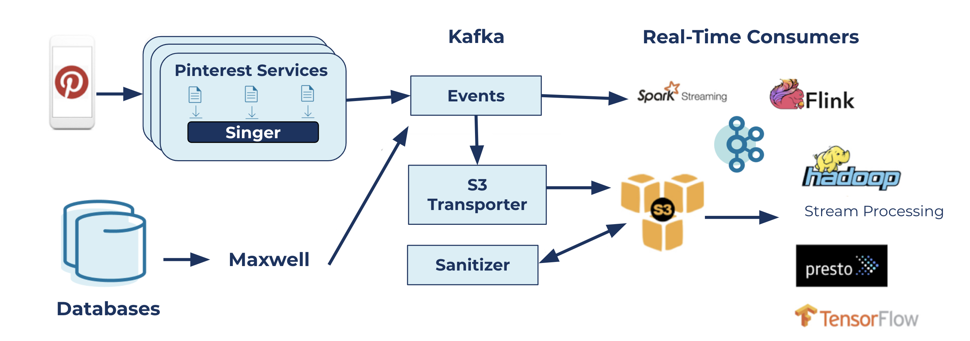
Pinterest uses Kafka to handle 40M events/s

Slide 6
Core Kafka Concepts Overview
Events/Messages
Topics
Partitions
Offsets
Brokers
Replication
Producers
Consumers
Consumer Groups
Zookeeper

Slide 7
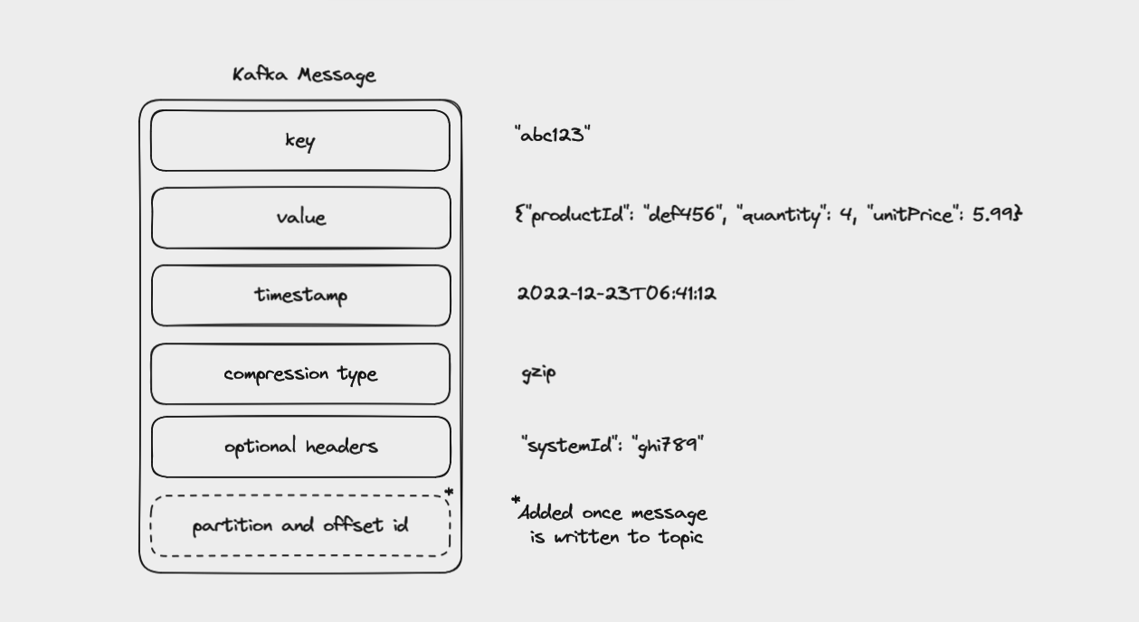
Events/Messages in Kafka
An event is a record of something that has happened.
It’s a combination of a notification (something occurred) and state (details about what occurred).
Stored as binary data (e.g., JSON, Avro).

Slide 8
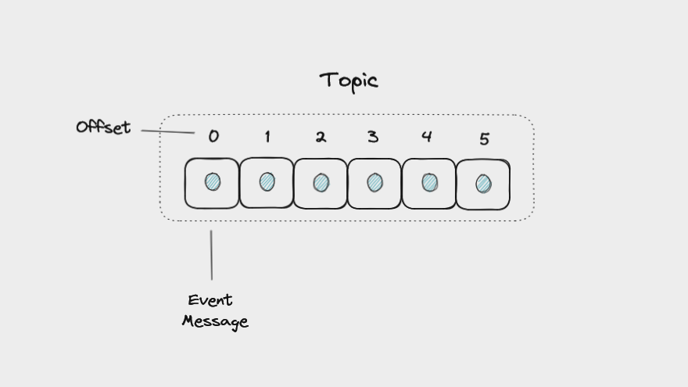
Topics in Kafka
A topic is a named category or container where Kafka stores similar events.
It’s like a logbook that keeps growing as new events are added.
Topics are append-only: New events go at the end.
Events are immutable: Once written, they can’t be changed.
Durable: Data stays until you set it to expire (default: 7 days).

Slide 9
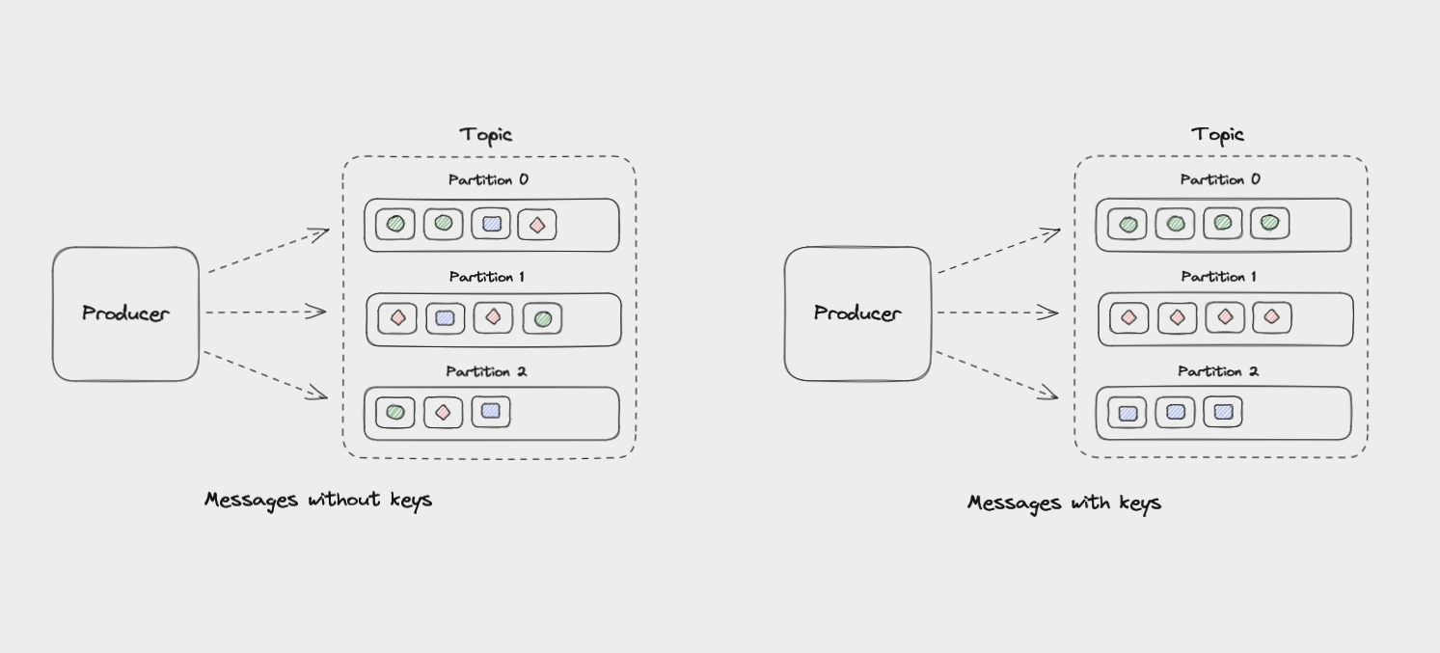
Partitions in Kafka
A partition is a way to split a topic into smaller pieces so they can be spread across multiple nodes in a Kafka cluster for better scaling.
Messages with same key go to same partition.
No key = round-robin distribution.

Slide 10
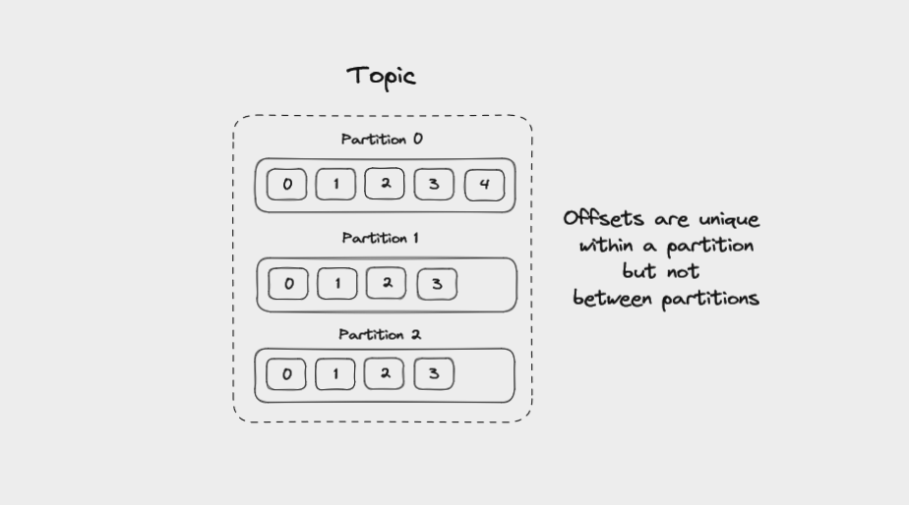
Offsets in Kafka
Each message in a partition gets an id that is an incrementing integer, called an offset.
Offsets start at 0 and are incremented every time Kafka writes a message to a partition.
It tracks order and position of messages.

Slide 11
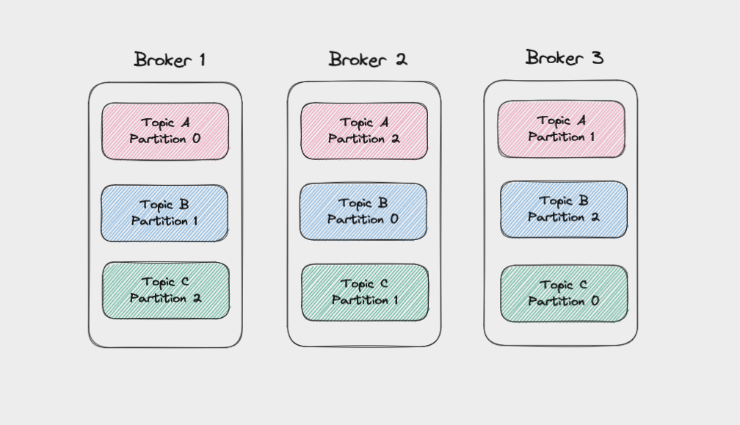
Brokers in Kafka
A servers in a Kafka cluster.
Manage partitions and handle read/write requests.
Scalable and fault-tolerant.

Slide 12
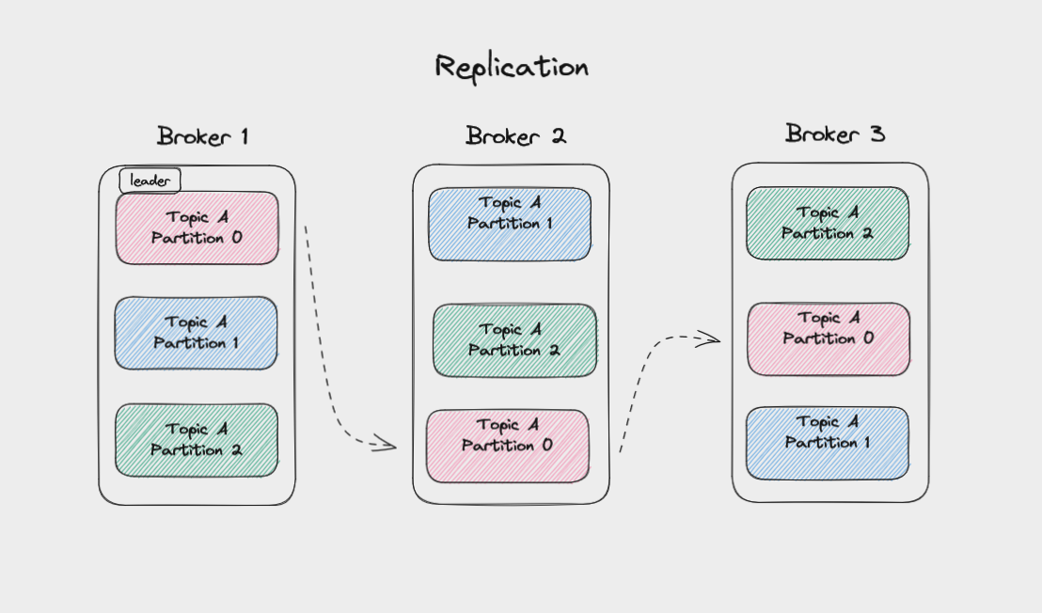
Replication in Kafka
Data copied across brokers (leader + followers).
Replication factor sets number of copies (e.g., 3).
The leader handles reads and writes.
Followers copy the leader’s data automatically.
If the leader fails, a follower becomes the new leader.

Slide 13
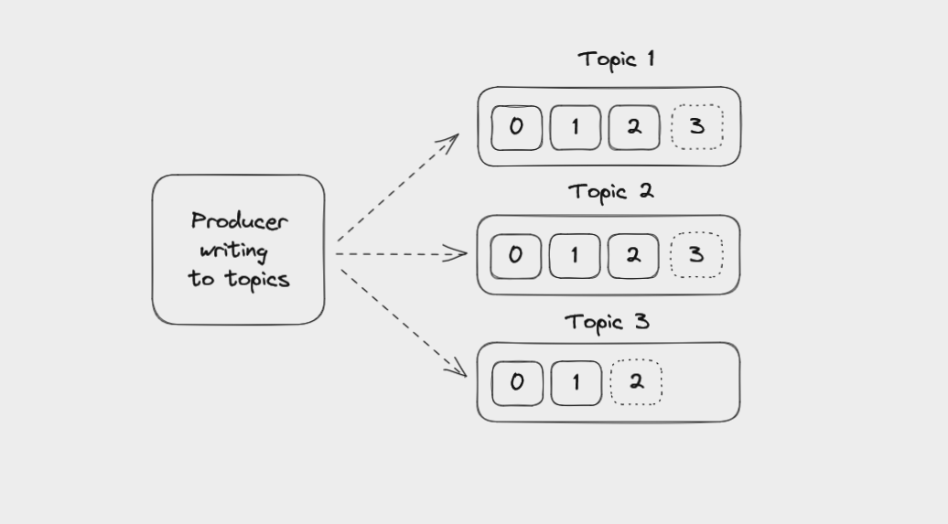
Producers in Kafka
An Application that sends (produce) events to topics.
Decide which partition to send to (key-based or round-robin).
Decoupled from consumers.

Slide 14
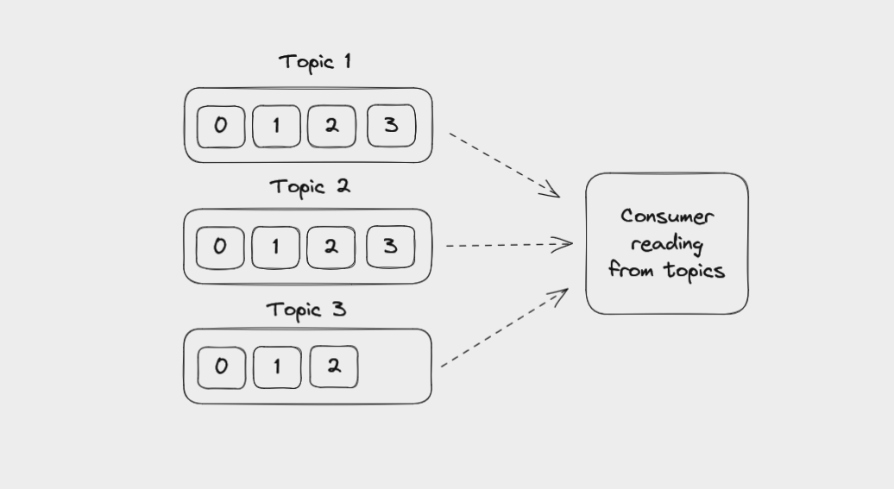
Consumers in Kafka
An Application that reads events from topics.
Consumers can read from one or more partitions within a topic, and from one or more topics.
Reading a message does not delete it. The message is still available to be read by any other consumer

Slide 15
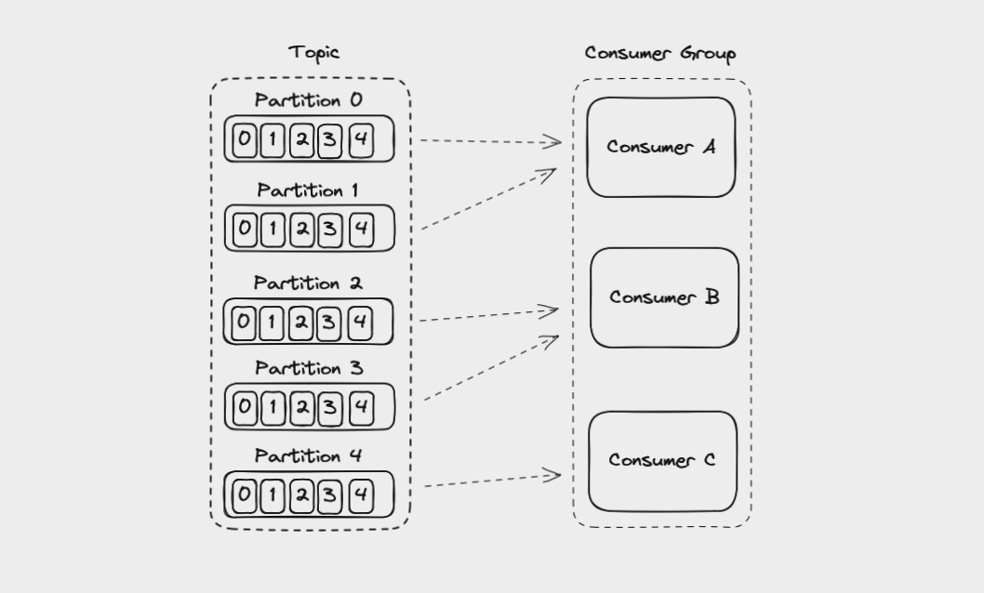
Consumer Groups in Kafka
Multiple consumers working together.
Each partition assigned to one consumer in the group.
Rebalances if consumers are added/removed.

Slide 16
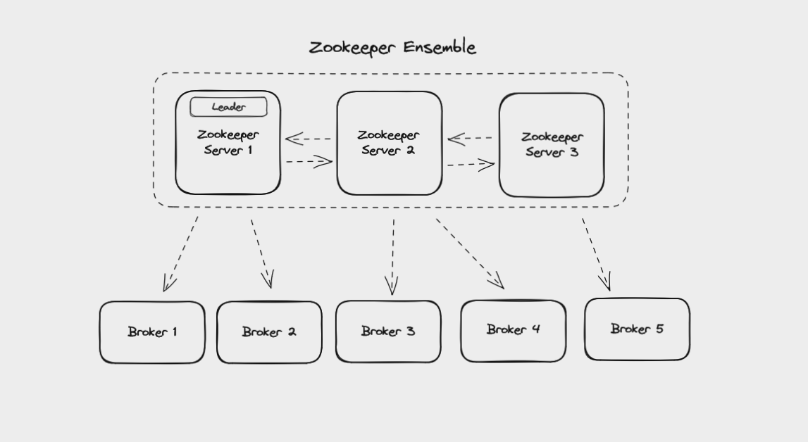
Kafka Zookeeper
Manages Kafka cluster (brokers, topics, partitions).
Tracks leaders, replicas, consumer groups.
Future: Kafka will self-manage (KIP-500).

Slide 17
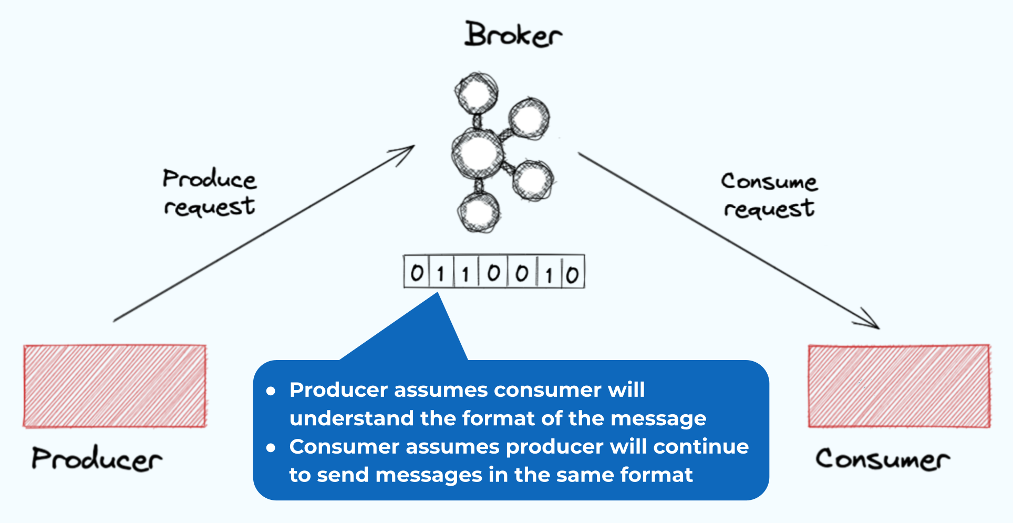
Schema Registry
Schema Registry is a service that manages the structure (schema) of events in Kafka topics.
Ensuring producers and consumers agree on the format.
Producers and consumers check with it to avoid mismatches.
Supports formats like JSON, Avro, and Protobuf.

Slide 18
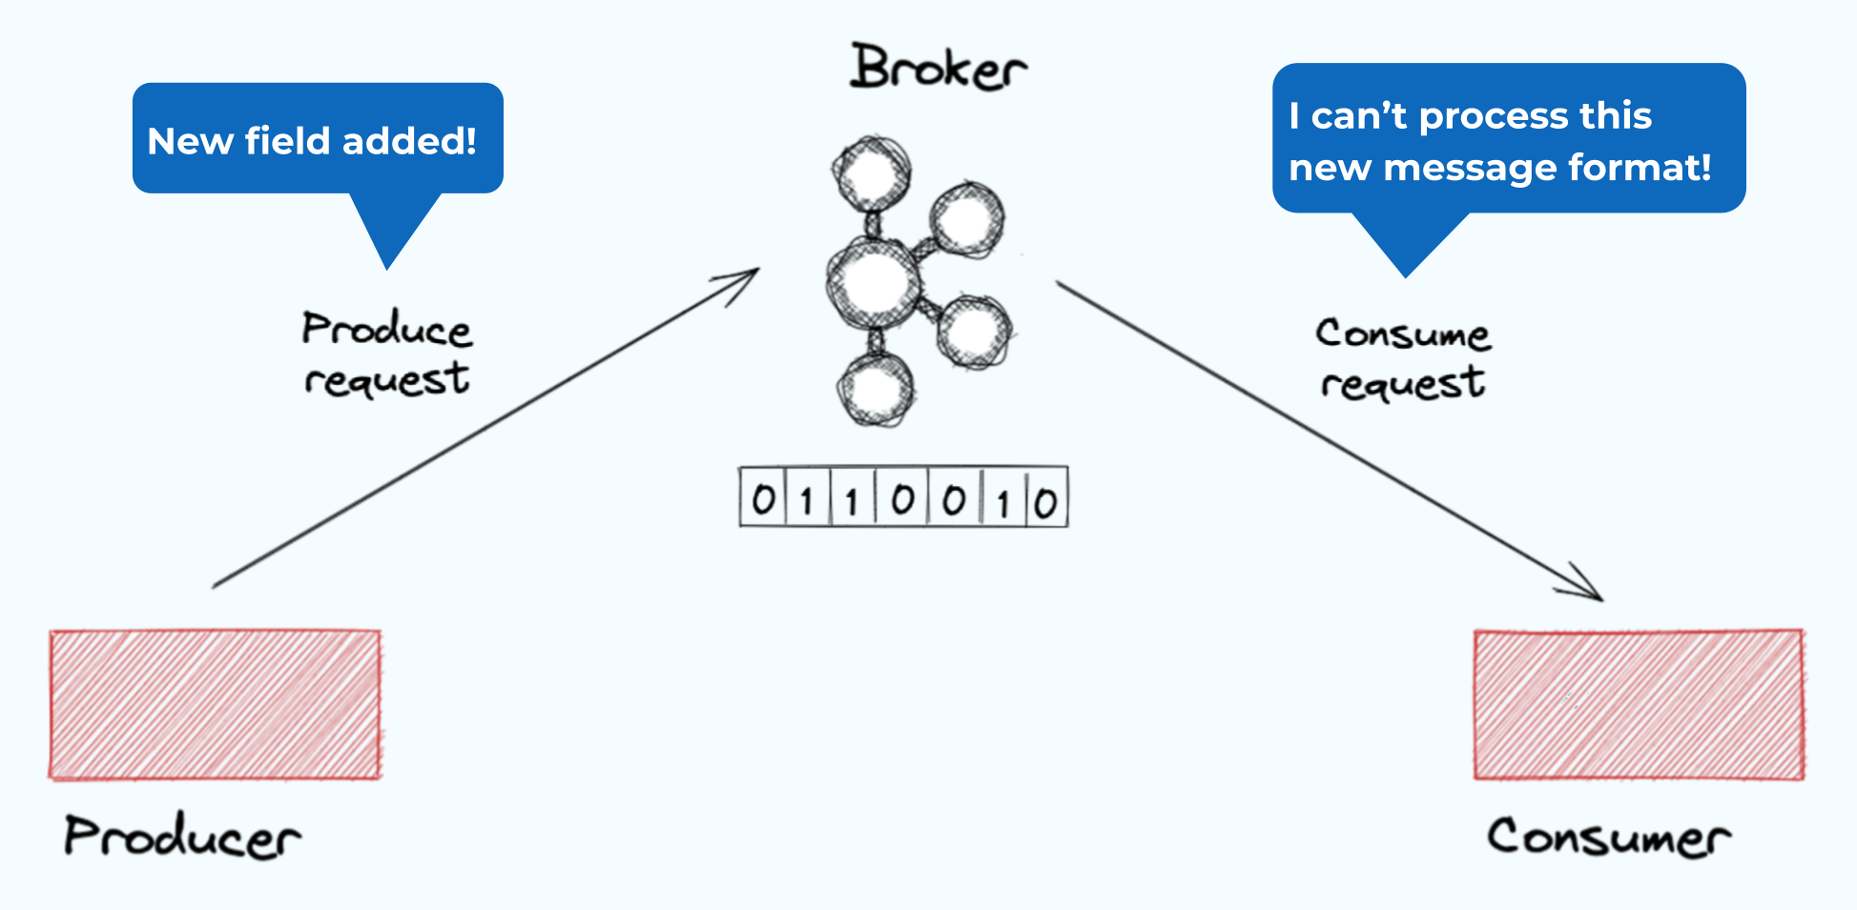
Why Use Schema Registry?
Consistency: Prevents mismatched data (e.g., missing fields).
Evolution: Updates schemas without breaking apps.
Efficiency: Stores schemas centrally, not in every message.

Slide 19
Schema Format: JSON
It’s a plain text, human-readable (e.g., {"id": 1, "name": "Alice"}).
In Schema Registry: Defines fields and types (e.g., int, string).
{
"type": "record",
"name": “User",
"fields": [
{"name": "id", "type": "int"},
{"name": “name", "type": "string"}
]
}

Slide 20
Schema Format: Avro
It using Binary format, compact and fast.
In Schema Registry: Stores .avsc files (e.g., in Schema Package).
{
"type": "record",
"name": "User",
"fields": [
{"name": "id", "type": "int"},
{"name": “name", "type": "string"}
]
}

Slide 21
Schema Format: Protobuf
It using Binary format, compact and fast.
In Schema Registry: Stores .proto files (e.g., in Schema Package).
syntax = "proto3";
message User {
int32 id = 1;
string name = 2;
}

Slide 22
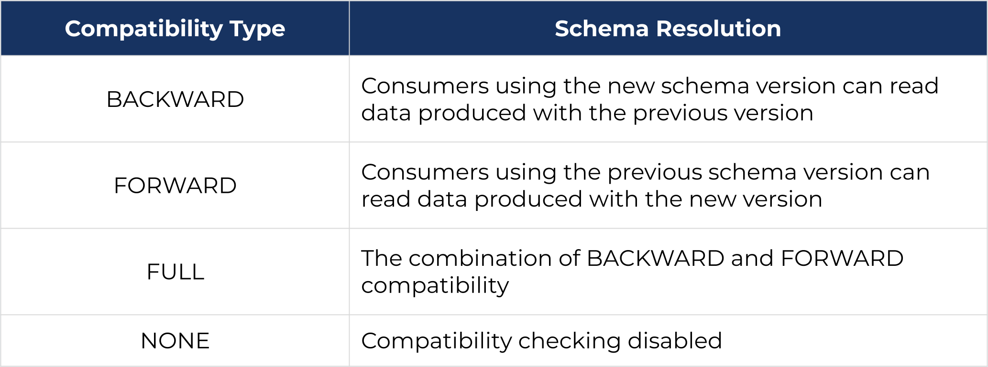
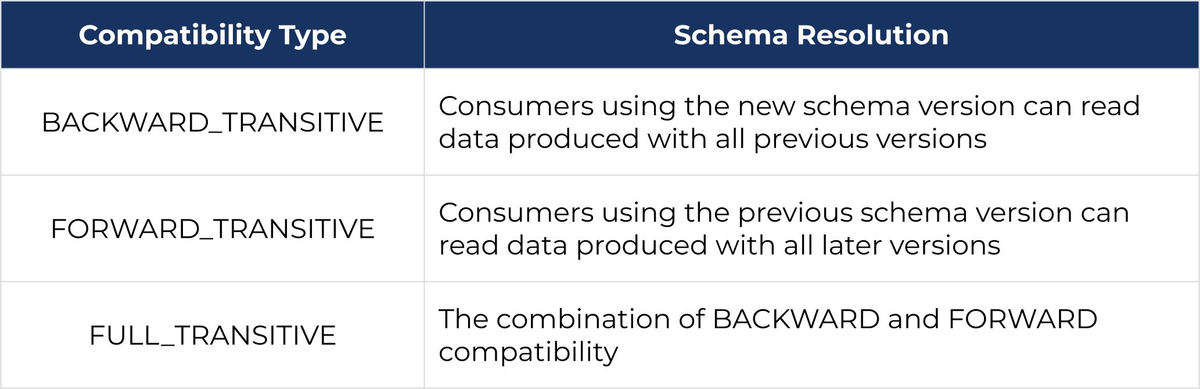
Schema Compatibility Modes

Slide 23
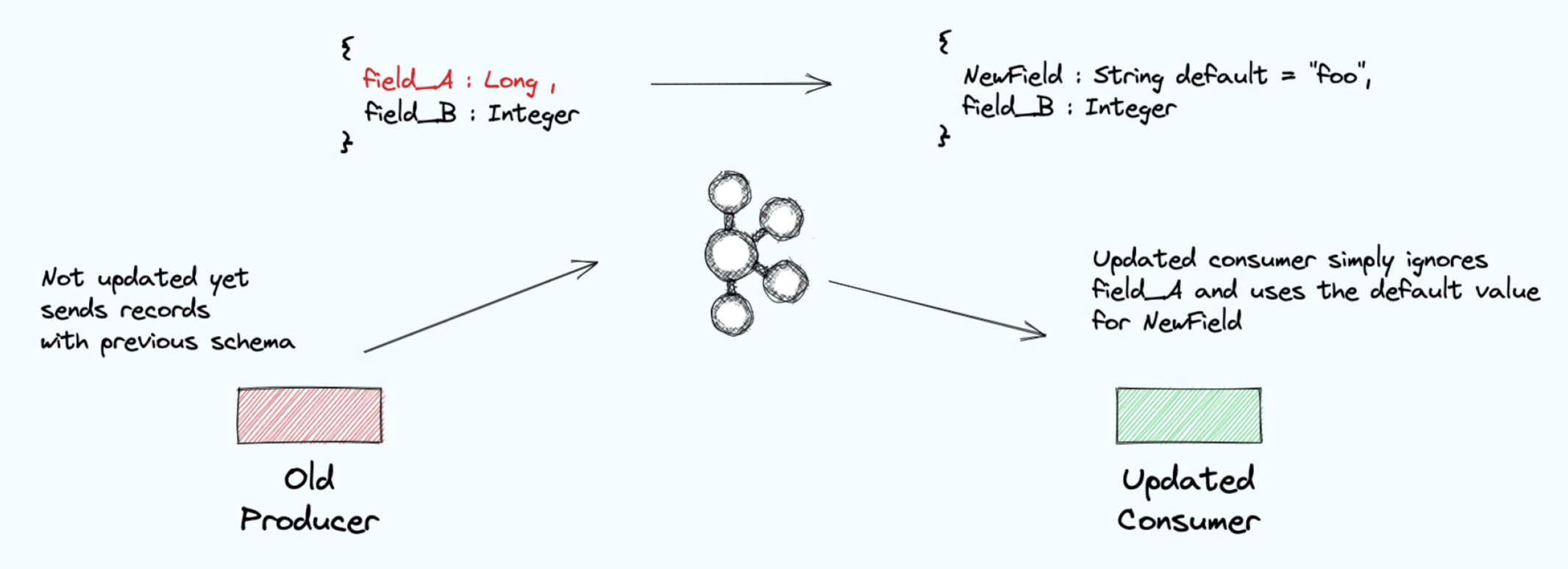
Backward Compatibility
If a producer using the previous schema version sends records to Kafka the updated consumer client using new schema version will continue to work fine.

Slide 24
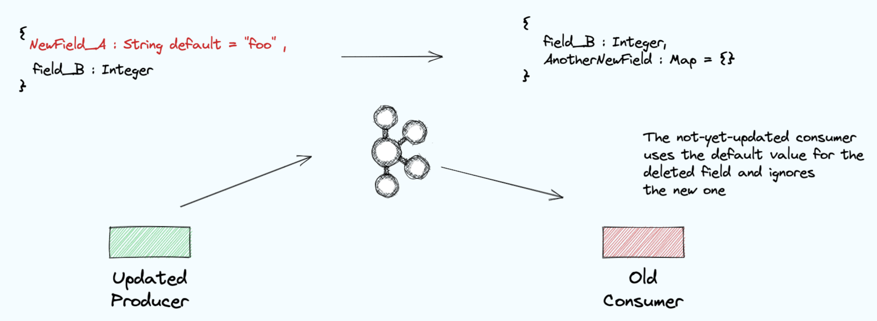
Forward Compatibility
If a producer using the new schema version sends records to Kafka the updated consumer client using previous schema version will continue to work fine.

Slide 25
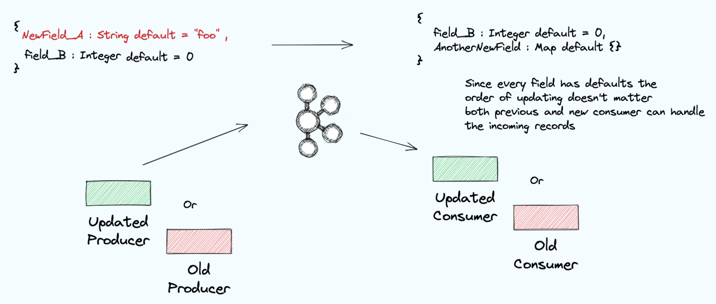
Full Compatibility
With full compatibility every field in the schema has a default value, so the order of updating clients doesn’t matter—with either order both old and new consumers will continue to work properly.

Slide 26
Introducing UI for Apache Kafka
What is Kafka UI?
A graphical tool to manage Kafka without commands.
View topics, partitions, messages, and brokers easily.
Key Features:
Cluster and topic management.
Consumer group insights.
Real-time monitoring and message visualization.
Inspect message data (keys, values, offsets).
Monitor broker health.

Slide 27
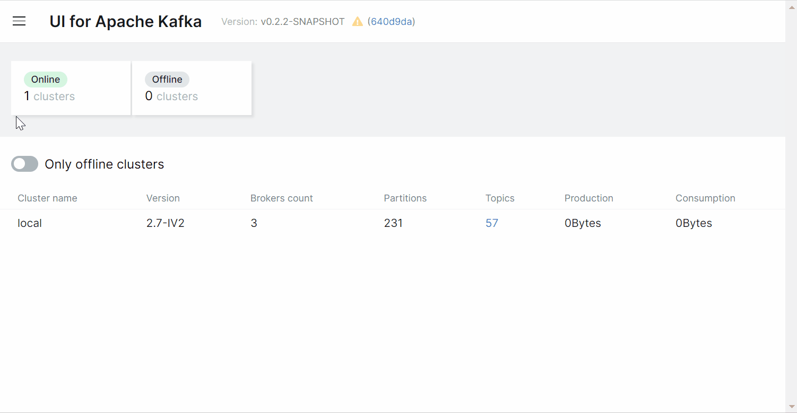
Kafka UI Interface

Slide 28
Q&A - Kafka Certification
Lets Complete Kafka Certification:
https://training.confluent.io/channeldetail/apache-kafka-fundamentals-and-accreditation

Slide 29


We travel with you as part of your business, taking the lead in promoting your brand to achieve new heights in the digital market.

